Slide 1
CS 110 - Professional Practices in IT Instructor Name : Dr Tariq Umer Email : tariqumer@cuilahore.edu.pk

Slide 2
Lecture - 5 CYBER CRIME

Slide 3
What We Will Cover
Hacking
Identity Theft and Credit Card Fraud
Scams and Forgery
Crime Fighting Versus Privacy and Civil Liberties
Laws That Rule the Web

Slide 4
Hacking
Hacking – currently defined as to gain illegal or unauthorized access to a file, computer, or network
The term has changed over time
Phase 1: early 1960s to 1970s (The joy of Programming)
It was a positive term
A "hacker" was a creative programmer who wrote elegant or clever code
A "hack" was an especially clever piece of code

Slide 5
Hacking (cont.)
Phase 2: 1970s to mid 1990s
Hacking took on negative connotations
Breaking into computers for which the hacker does not have authorized access
Still primarily individuals
Companies began using hackers to analyze and improve security

Slide 6
Hacking (cont.)
Phase 3: beginning with the mid 1990s
The growth of the Web changed hacking;
viruses and worms could be spread rapidly
Many other forms of hacking are:
Political hacking (Hacktivism) surfaced
Denial-of-service (DoS) attacks used to shut down Web sites
Large scale theft of personal and financial information

Slide 7
Hacking (cont.)
Hacktivism, or Political Hacking:
Use of hacking to promote a political cause (PROTEST).
In free countries with FOS hacking website to promote political cause is unjustifiable.
Activists can Promote their cause using FOS.
We have Freedom to Speak but not have right to compel to others to listen. Crashing a website is similar.
Nations with no FOS (no respect for civil disobedience) ethically justifies hacktivism.
Some use the appearance of hacktivism to hide other criminal activities

Slide 8
Hacking(cont.)
How do you determine whether something is hacktivism (Political activists: Act of shutdown is political action i.e Activism) or simple vandalism and theft (Customer or Owner: Deliberate destruction or damage of public or other people's property)?

Slide 9
Hacking(cont.)
A fundamental problem with evaluating political hacking is that it can be hard to identify.
People who agree with the political or social position of the hackers will tend to see an act as “activism,” while those who disagree will tend to see it as ordinary crime (or worse).
To some political activists, any act that shuts down or steals from a large corporation is a political act. To the customers and owners, it is vandalism and theft.

Slide 10
Hacking (cont.)
The Law: Catching and Punishing Hackers:
1986 Congress passed the Computer Fraud and Abuse Act (CFAA)
Covers government computers, financial and medical systems, and activities that involve computers in more than one state, including computers connected to the Internet
Anti-hacking law, Denial of service and malicious programs
The USA Patriot Act expanded the definition of loss to include the cost of responding to an attack, assessing damage and restoring systems
Raised penalties to 10 years

Slide 11
Hacking (cont.)
A variety of methods for catching hackers
Law enforcement agents read hacker newsletters and participate in chat rooms undercover
Computer forensics (Scientific tests or techniques used in the investigation of crimes) is used to retrieve evidence from computers

Slide 12
Hacking (cont.)
Penalties for young hackers
Many young hackers have matured and gone on to productive and responsible careers
Sentencing depends on intent and damage done
Most young hackers receive probation, community service, and/or fines

Slide 13
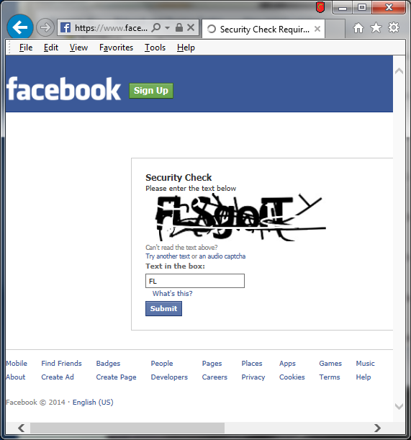
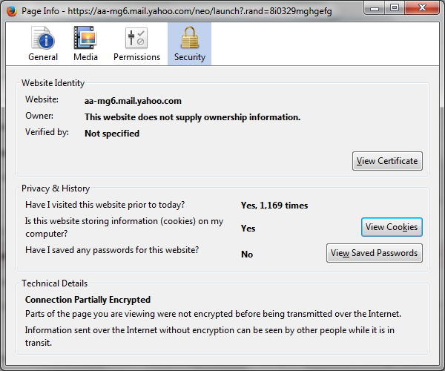
Security check

Slide 14
Hacking (cont.)
Responsibility for Security
Developers have a responsibility to develop with security as a goal
Businesses have a responsibility to use security tools and monitor their systems to prevent attacks from succeeding
Home users have a responsibility to ask questions and educate themselves on the tools to maintain security (personal firewalls, anti-virus)

Slide 15
Hacking-Discussion Questions
Do you think hiring former hackers to enhance security is a good idea or a bad idea? Why?

Slide 16
Identity Theft and Credit Card Fraud
Stealing Identities (Identity Theft ):
Various crimes in which a criminal or large group uses the identity of an unknowing, innocent person
Use credit/debit card numbers, personal information, and social security numbers
18-29 year-olds are the most common victims because they use the web most and are unaware of risks
E-commerce has made it easier to steal card numbers and use without having the physical card

Slide 17
Identity Theft and Credit Card Fraud (cont.)
Techniques used to steal personal and financial information
Phishing - e-mail fishing for personal and financial information disguised as legitimate business e-mail
Pharming - false Web sites that fish for personal and financial information by planting false URLs in Domain Name Servers
Online resumes and job hunting sites may reveal SSNs, work history, birth dates and other information that can be used in identity theft

Slide 18
Identity Theft and Credit Card Fraud (cont.)
Techniques used to protect personal and financial information
Activation for new credit cards
Retailers do not print the full card number and expiration date on receipts
Software detects unusual spending activities and will prompt retailers to ask for identifying information
Services, like PayPal, act as third party allowing a customer to make a purchase without revealing their credit card information to a stranger

Slide 19
Identity Theft and Credit Card Fraud (cont.)
Responses to Identity Theft:
Authentication of e-mail and Web sites
Use of encryption to securely store data, so it is useless if stolen
Authenticating customers to prevent use of stolen numbers, may trade convenience for security
In the event information is stolen, a fraud alert can flag your credit report; some businesses will cover the cost of a credit report if your information has been stolen

Slide 20
Identity Theft and Credit Card Fraud (cont.)
Biometrics:
Biological characteristics unique to an individual (Finger, Voice, Face structure, hand geometry, eye pattern, and DNA.
No external item (card, keys, etc.) to be stolen
Used in areas where security needs to be high, such as identifying airport personnel.
Biometrics can be fooled, but more difficult to do so, especially as more sophisticated systems are developed. (pupil contract, live tissue of finger and real face)

Slide 21
Scams and Forgery
Auctions:
Federal Trade Commission reports show that online auction sites are one of the top sources of fraud complaints
Some sellers do not send items or send inferior products
Shill bidding is used to artificially raise prices
Sellers give themselves or friends glowing reviews to garner consumer trust

Slide 22
Crime Fighting Vs. Privacy and . . . (cont.)
Cybercrime Treaty:
International agreement to foster international cooperation among law enforcement agencies of different countries in fighting copyright violations, fraud, hacking and other online fraud
Treaty sets common standards or ways to resolve international cases

Slide 23
Whose Laws Rule the Web (Cont.)
Arresting Foreign Visitors:
A Russian citizen was arrested for violating the Digital Millennium Copyright Act DMCA when he visited the U.S. to present a paper at a conference; his software was not illegal in Russia
An executive of a British online gambling site was arrested as he transferred planes in Dallas (online sports betting is not illegal in Britain)

Slide 24
Conclusion
Hacking
Identity Theft and Credit Card Fraud
Scams and Forgery
Crime Fighting Versus Privacy and Civil Liberties
Laws That Rule the Web

